Slide 1
Servo and Stepper Motor Interfacing
Team members:
Joel Manish Pinto
Vishal H. Rajai
Mentor:
Bhavin Upadhyay

Slide 2
Project Idea and Work Assigned
The main project idea is to learn about different kinds of motors and apply the knowledge to design and make a robotic arm.
Work assigned:
Study different kind of motors (stepper and servo motors).
Interface both motors with the AVR-based Firebird V.
Interface both motors again with the ARM controller.
Study concepts like DOF, actuators, joints, etc. needed for designing a robotic arm.
Design and make a robotic arm with a gripper.
Work on creating an effective method to control the robotic arm (wired/wireless).

Slide 3
Completion Status
Studied internal working and fundamental principles of servo and stepper motors.
Interfaced both motors with ATmega2560.
Programmed controller for driving stepper motor in both directions in full step, half step and wave step modes.
Wrote a header file with code for driving multiple servo motors simultaneously with 1⁰ precision.
Implemented servo speed control.
Experimented on servo by running it on a wide range of PWM operating frequency and studying the effect on the torque.
Practically analysed relation between step frequency vs. current consumption thereby giving us an idea of the speed vs. torque curve for a stepper motor.

Slide 4
Studied the concept of ‘Degrees of Freedom’.
Acquired basic idea regarding ARM family MCUs and its general architecture.
Coded the simple Buzzer Beep example for ARM7 (LPC2148).
Interfaced servo motor with LPC2148 (with 1⁰ precision).

Slide 5
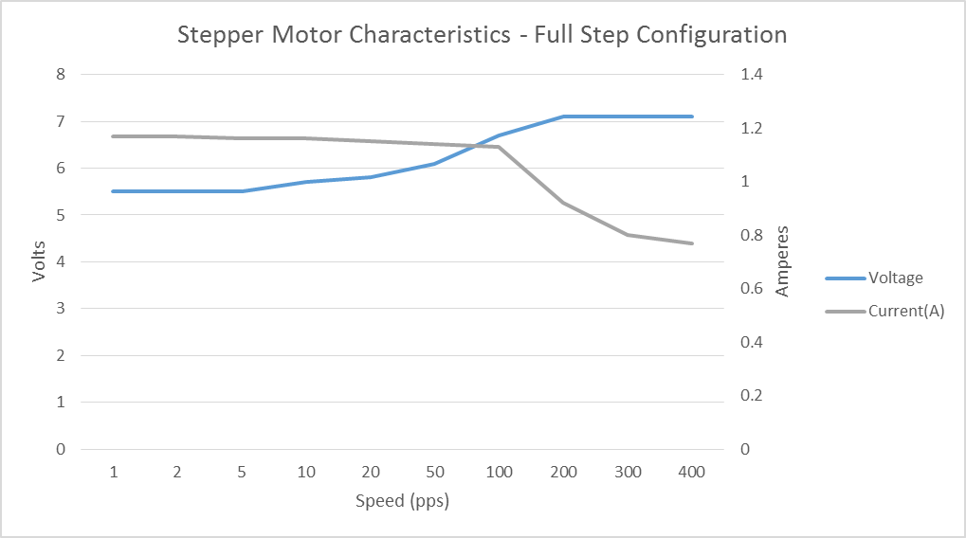
Stepper Motor Characteristics

Slide 6
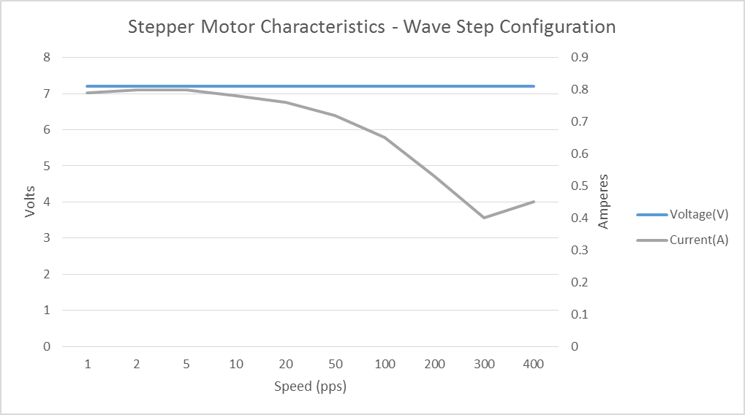

Slide 7
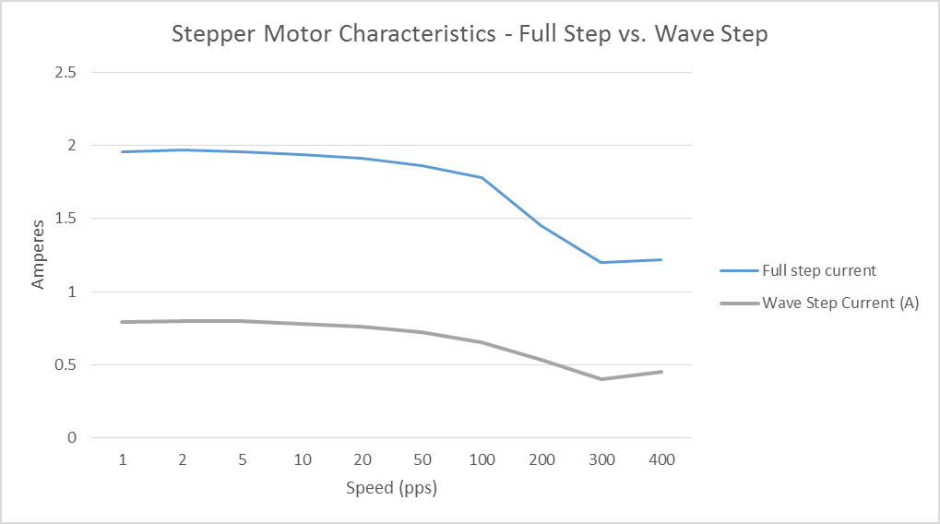

Slide 8
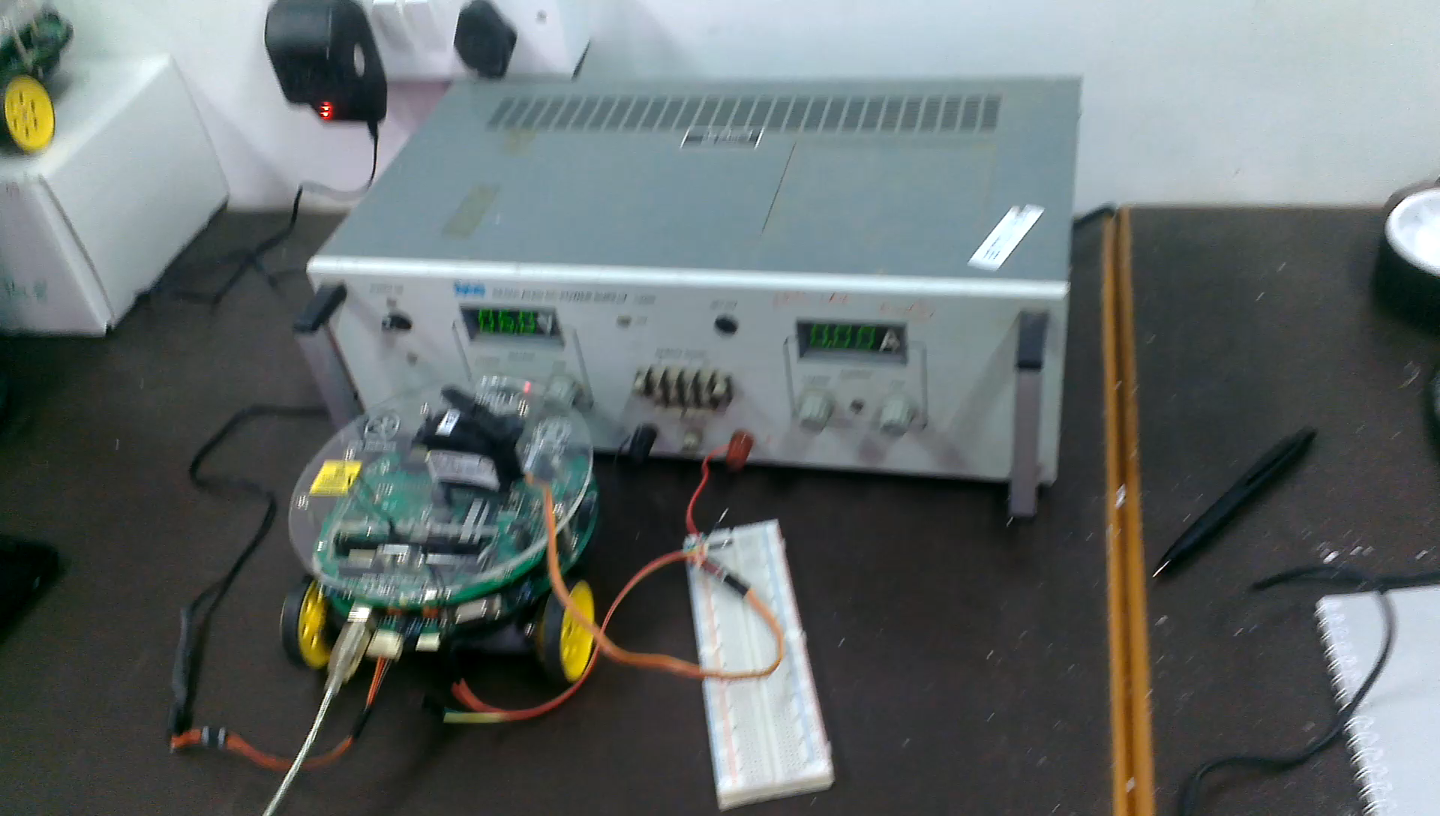
Servo Speed Control Demo

Slide 9
Role of each member:
Basically, we both worked as a team.
Studied motors from various sources, discussed and shared knowledge with each other
Developed algorithms for different programs
Coding was mostly done by Joel.
Mathematical eqs and simplifying them was mostly done by Vishal.
We both helped each other understanding different concepts like different types of torques, DOF, architecture of ARM, etc. by learning it from various sources and discussing it with each other.

Slide 10
Experience of last two weeks in project
Excellent atmosphere for learning and concentrating on work
Helpful and guiding mentors
Easy access to otherwise expensive components like power supply units, servos, oscilloscope, etc.
Enjoyed the ‘learning while doing’ experience.
Came across people from different parts of the country striving to achieve a common goal.
Got an opportunity to work on an ARM microcontroller for the first time.
Greatly increased our understanding about servo and stepper motors.
Applied Control Theory concepts for the first time in real life.

Slide 11
Planning for next four weeks
This week:
We would be ready with documentation and video tutorials for interfacing both motors with both controllers and for other things like speed control, etc. till end of this week.
Would interface stepper motor with LPC2148.
We would be studying actuators, joints, etc. materials needed for designing a robotic arm
Next 3 weeks:
We are planning to come up with a basic working prototype of a robotic arm and explore various methods for controlling it wirelessly.

Slide 12
Thank You

